Slide 1
For the Love of Animals
United Animal Services
Michael Amoo

Slide 2
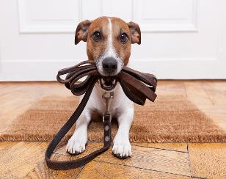
Meet our mascot, Daisy!

Slide 3
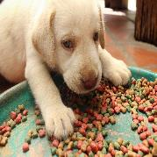
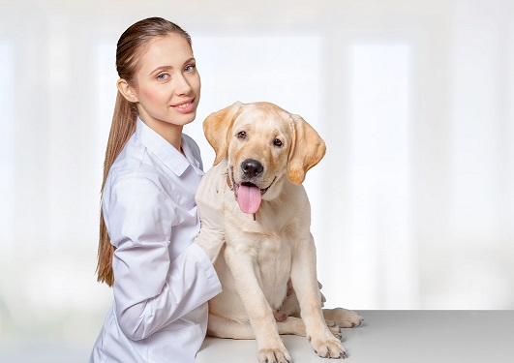
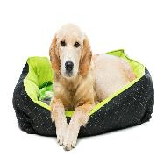
How we use your donations
Food
Medical
Shelter

Slide 4
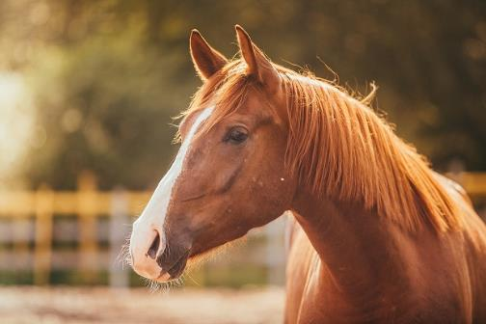
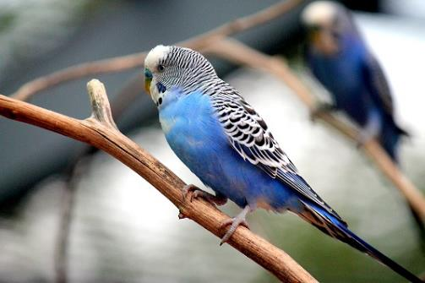
Big Red
Baby Blue

Slide 5
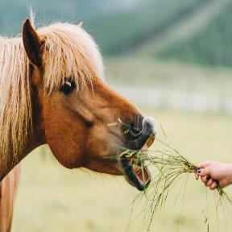
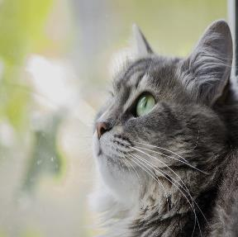

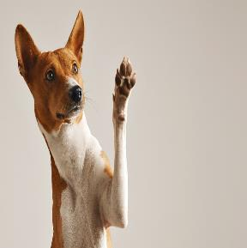

Every pet deserves a home
Every pet deserves a loving home

Slide 6

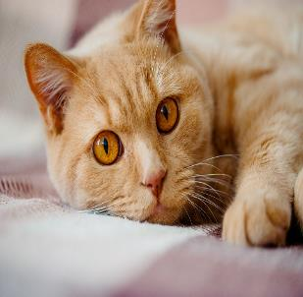
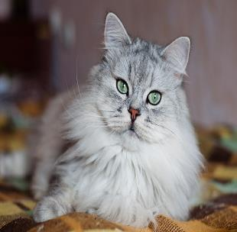
Purr-fect felines

Slide 7
Training is an important part of what we do

Slide 8
The adoption process
Animal
Animal arrives at UAS
Adopter
Wants a pet
Happy Family
Spend time together at UAS
Medical and behavioral exam
Can provide good care
Take animal home

Slide 9
How your dollars are used

Slide 10
Where we get our funding
Source | Average Yearly Amount
Wills and trusts | 500,000
Corporate donations | 375,000
Individual donations | 250,00
Charity events | 225,00
Anonymous donations | 100,000

